Slide 1
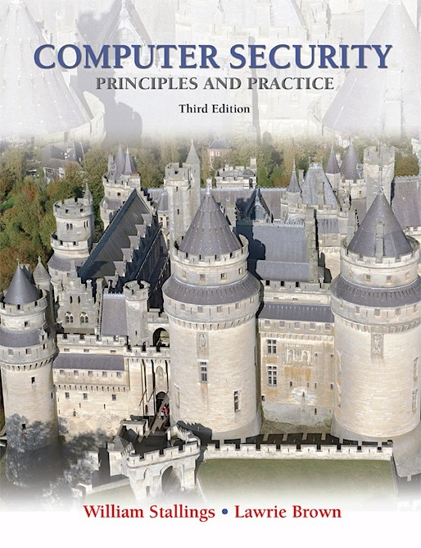
Lecture 22 Legal and Ethical Aspects
modified from slides of Lawrie Brown

Slide 2
Legal and Ethical Aspects
touch on a few topics including:
cybercrime and computer crime
intellectual property issues
privacy
ethical issues
Notes:
The legal and ethical aspects of computer security encompass a broad range of topics, and a full discussion is well beyond the scope of this book, however we touch on a few important topics in this area, including: cybercrime and computer crime; intellectual property issues; privacy and ethical issues.

Slide 3
Cybercrime / Computer Crime
“Computer crime, or cybercrime, is a term used broadly to describe criminal activity in which computers or computer networks are a tool, a target, or a place of criminal activity.”
--From the New York Law School Course on
Cybercrime, Cyberterrorism, and Digital
Law Enforcement
Notes:
Computer crime , or cybercrime , is a term used broadly to describe criminal activity
in which computers or computer networks are a tool, a target, or a place of criminal
activity. These categories are not exclusive, and many activities can be characterized
as falling in one or more categories. The term cybercrime has a connotation of
the use of networks specifically, whereas computer crime may or may not involve
networks.

Slide 4
Types of Computer Crime
The U.S. Department of Justice categorizes computer crime based on the role that the computer plays in the criminal activity:
Computers as targets
Computers as storage devices
Computers as communications tools
Involves an attack on data integrity, system integrity, data confidentiality, privacy, or availability
Using the computer to store stolen password lists, credit card or calling card numbers, proprietary corporate information, pornographic image files, or pirated commercial software
Crimes that are committed online, such as fraud, gambling, child pornography, and the illegal sale of prescription drugs, controlled substances, alcohol, or guns
Notes:
The U.S. Department of Justice [DOJ00] categorizes computer crime based
on the role that the computer plays in the criminal activity, as follows:
• Computers as targets: This form of crime targets a computer system, to
acquire information stored on that computer system, to control the target
system without authorization or payment (theft of service), or to alter the
integrity of data or interfere with the availability of the computer or server.
Using the terminology of Chapter 1 , this form of crime involves an attack on
data integrity, system integrity, data confidentiality, privacy, or availability.
• Computers as storage devices: Computers can be used to further unlawful
activity by using a computer or a computer device as a passive storage medium.
For example, the computer can be used to store stolen password lists, credit
card or calling card numbers, proprietary corporate information, pornographic
image files, or “warez” (pirated commercial software).
• Computers as communications tools: Many of the crimes falling within this
category are simply traditional crimes that are committed online. Examples
include the illegal sale of prescription drugs, controlled substances, alcohol,
and guns; fraud; gambling; and child pornography.

Slide 5
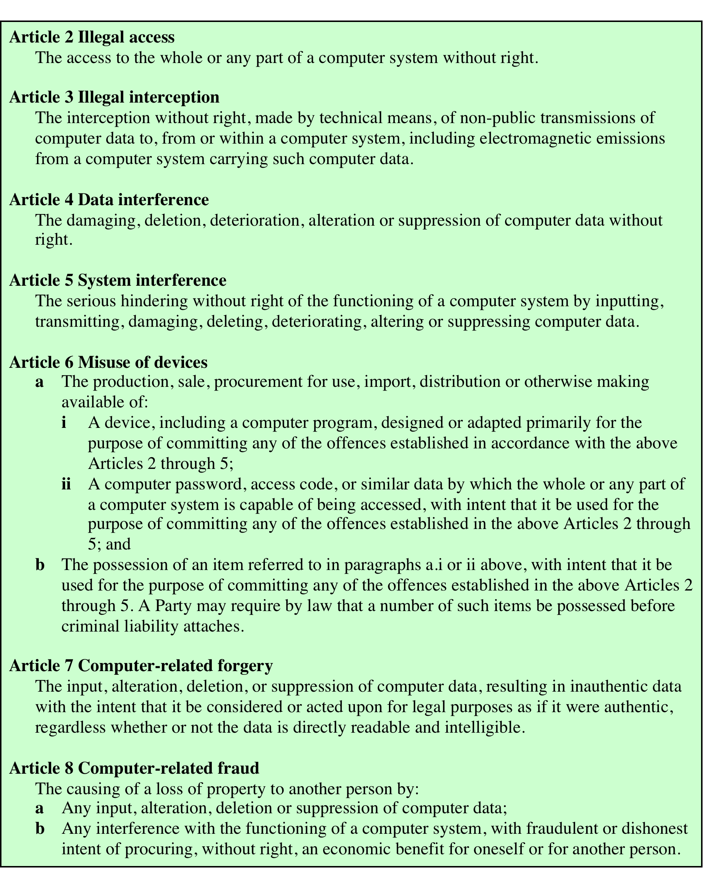
Table 19.1 Cybercrimes Cited in the International Convention on Cybercrime (page 1 of 2)
Notes:
A more specific list of crimes, shown in Table 19.1 , is defined in the
international Convention on Cybercrime. This is a useful list because it represents
an international consensus on what constitutes computer crime, or cybercrime, and
what crimes are considered important.

Slide 6
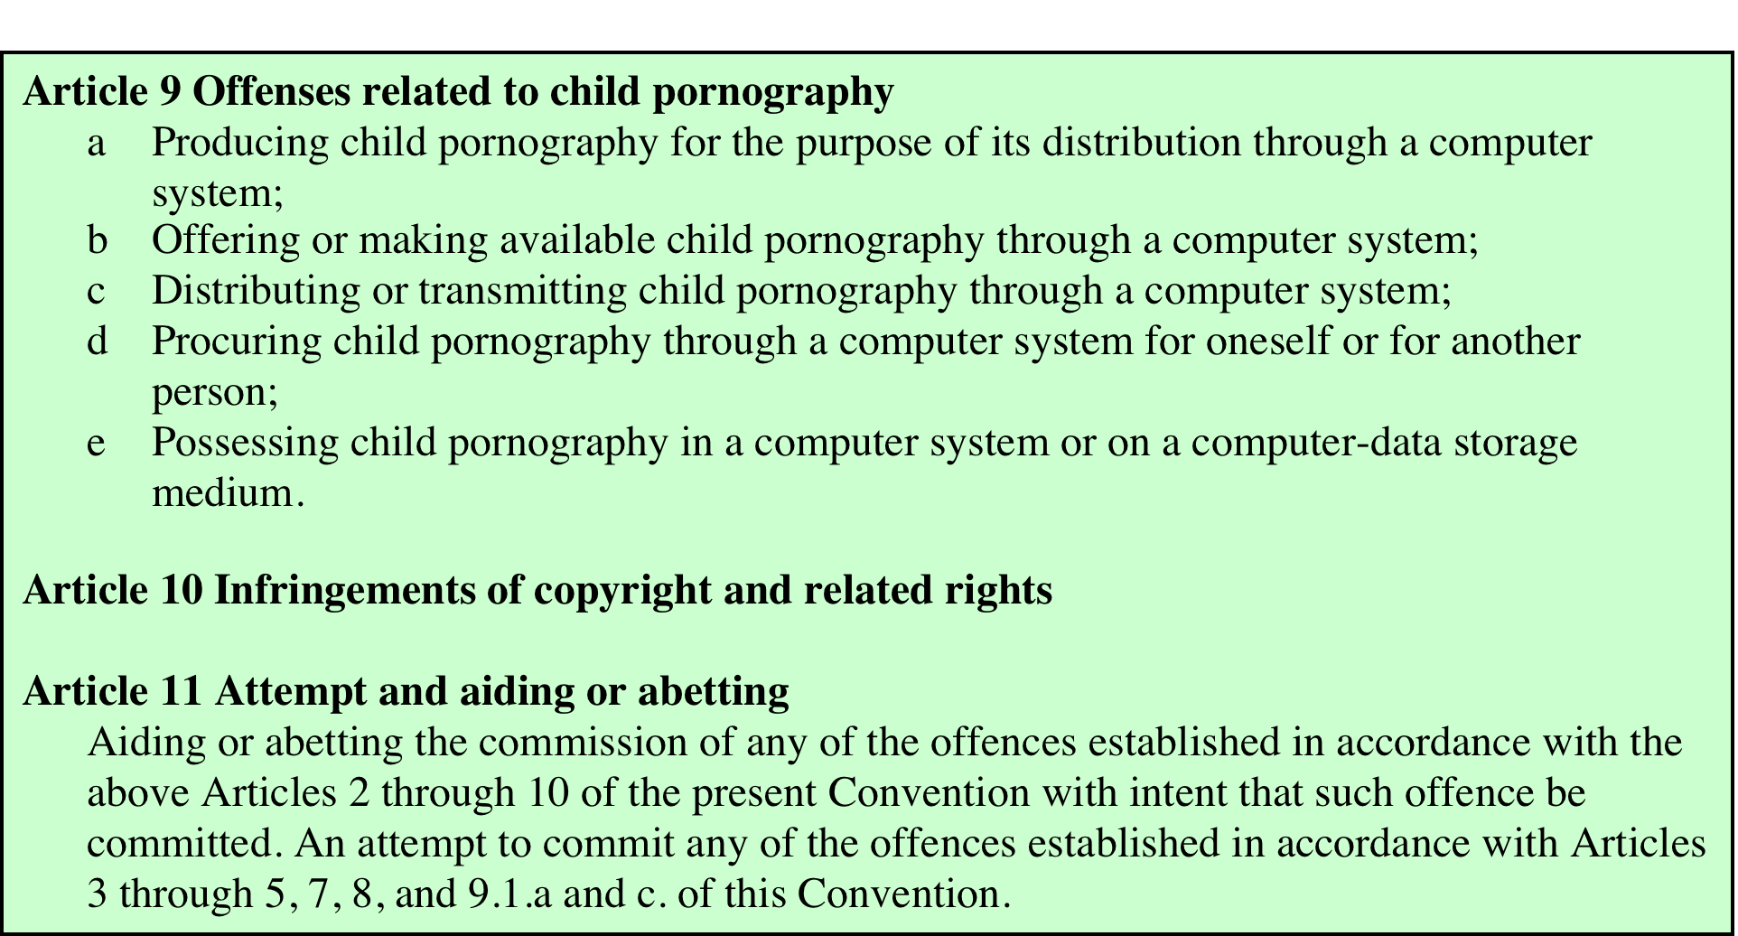
Table 19.1 Cybercrimes Cited in the International Convention on Cybercrime (page 2 of 2)
Notes:
Table 19.1 Cybercrimes Cited in the Convention on Cybercrime. Page 2 of 2.

Slide 7
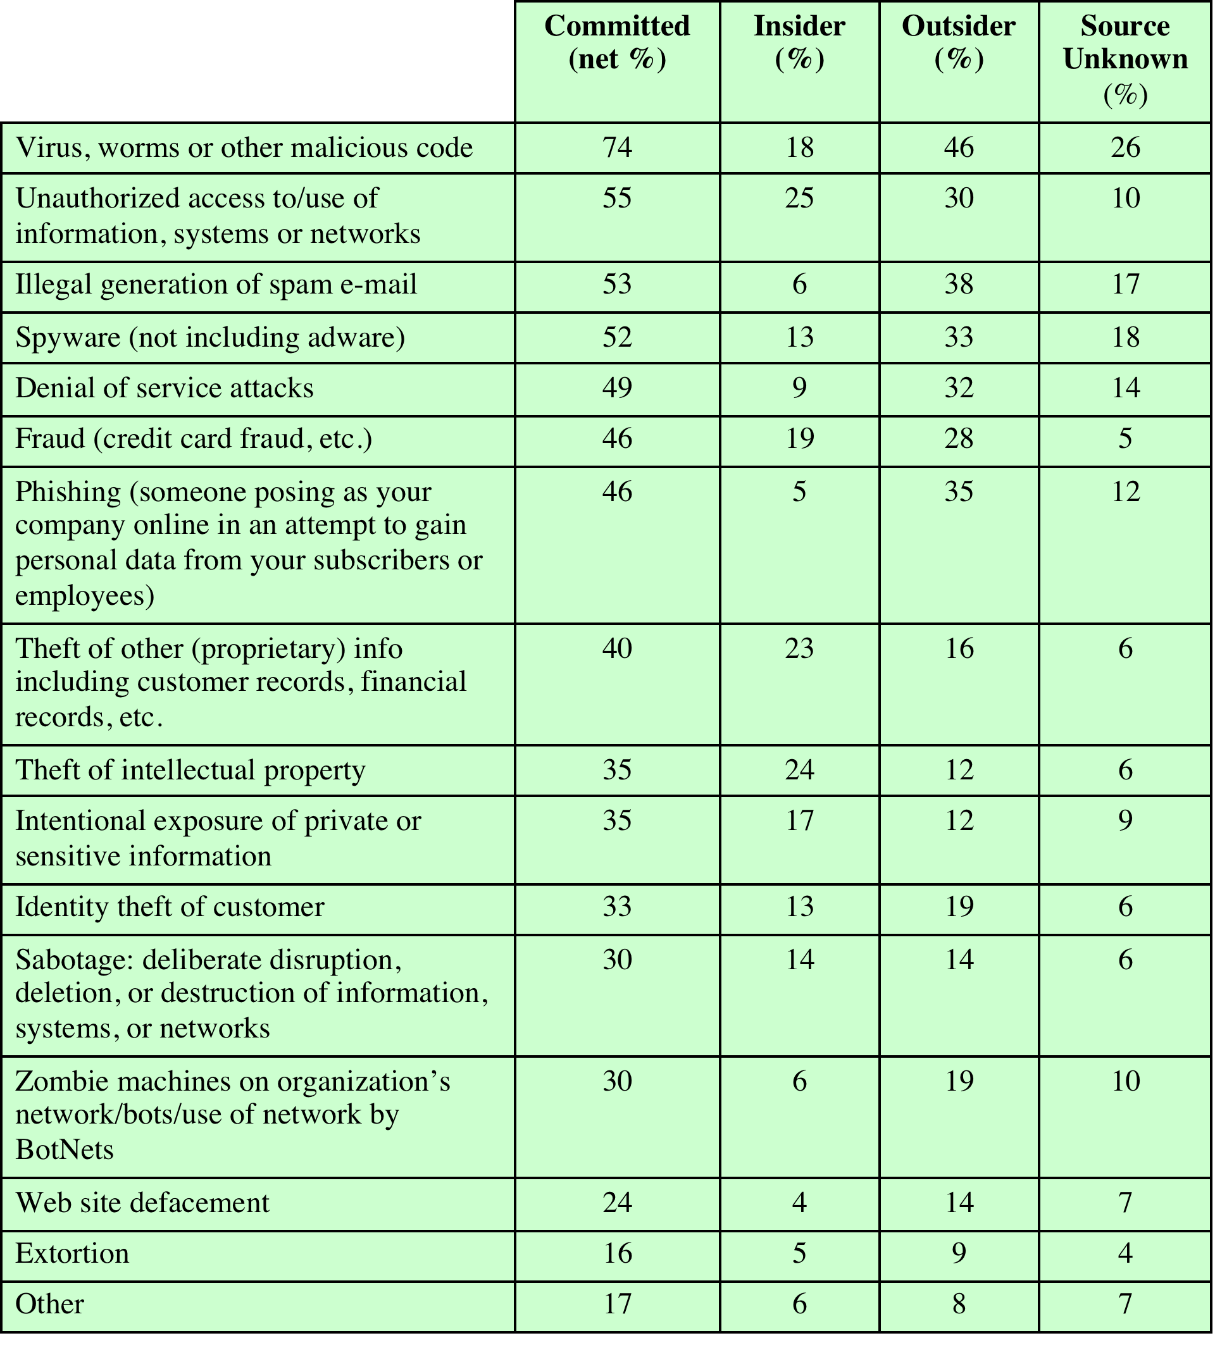
Table 19.2 CERT 2007 E-Crime Watch Survey Results
(Table can be found on page 614 in the textbook)
Notes:
Yet another categorization is used in the CERT 2007 E-crime Survey, the
results of which are shown in Table 19.2 . The figures in the second column indicate
the percentage of respondents who report at least one incident in the corresponding
row category. Entries in the remaining three columns indicate the percentage of
respondents who reported a given source for an attack.

Slide 8
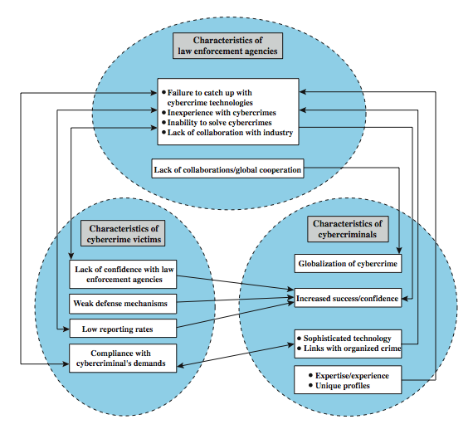

Law Enforcement Challenges

Slide 9
Law Enforcement Challenges
The deterrent effect of law enforcement on computer and network attacks correlates with the success rate of criminal arrest and prosecution
Law enforcement agency difficulties:
Lack of investigators knowledgeable and experienced in dealing with this kind of crime
Required technology may be beyond their budget
The global nature of cybercrime
Lack of collaboration and cooperation with remote law enforcement agencies
Convention on Cybercrime introduces a common terminology
for crimes and a framework for harmonizing laws globally
Notes:
The deterrent effect of law enforcement on computer and network attacks correlates
with the success rate of criminal arrest and prosecution. The nature of cybercrime
is such that consistent success is extraordinarily difficult. To see this, consider what
[KSHE06] refers to as the vicious cycle of cybercrime, involving law enforcement
agencies, cybercriminals, and cybercrime victims.
For law enforcement agencies , cybercrime presents some unique difficulties.
Proper investigation requires a fairly sophisticated grasp of the technology.
Although some agencies, particularly larger agencies, are catching up in this
area, many jurisdictions lack investigators knowledgeable and experienced in
dealing with this kind of crime. Lack of resources represents another handicap.
Some cybercrime investigations require considerable computer processing
power, communications capacity, and storage capacity, which may be beyond the
budget of individual jurisdictions. The global nature of cybercrime is an additional
obstacle: Many crimes will involve perpetrators who are remote from the target
system, in another jurisdiction or even another country. A lack of collaboration and
cooperation with remote law enforcement agencies can greatly hinder an investigation.
Initiatives such as international Convention on Cybercrime are a promising
sign. The Convention at least introduces a common terminology for crimes and a
framework for harmonizing laws globally.

Slide 10
Cybercriminals
The lack of success in bringing them to justice has led to an increase in their numbers, boldness, and the global scale of their operations
Are difficult to profile
Tend to be young and very computer-savvy
Range of behavioral characteristics is wide
No cybercriminal databases exist that can point to likely suspects
Notes:
The relative lack of success in bringing cybercriminals to justice has led to an
increase in their numbers, boldness, and the global scale of their operations. It is
difficult to profile cybercriminals in the way that is often done with other types of
repeat offenders. The cybercriminal tends to be young and very computer-savvy,
but the range of behavioral characteristics is wide. Further, there exist no cybercriminal
databases that can point investigators to likely suspects.

Slide 11
Cybercrime Victims
Are influenced by the success of cybercriminals and the lack of success of law enforcement
Many of these organizations have not invested sufficiently in technical, physical, and human-factor resources to prevent attacks
Reporting rates tend to be low because of a lack of confidence in law enforcement, concern about corporate reputation, and a concern about civil liability
Notes:
The success of cybercriminals, and the relative lack of success of law enforcement,
influence the behavior of cybercrime victims . As with law enforcement, many
organizations that may be the target of attack have not invested sufficiently in technical,
physical, and human-factor resources to prevent attacks. Reporting rates tend to
be low because of a lack of confidence in law enforcement, a concern about corporate
reputation, and a concern about civil liability. The low reporting rates and the
reluctance to work with law enforcement on the part of victims feeds into the handicaps
under which law enforcement works, completing the vicious cycle.
Executive management and security administrators need to look upon law enforcement
as another resource and tool, alongside technical, physical, and human-factor
resources. The successful use of law enforcement depends much more on people
skills than technical skills. Management needs to understand the criminal investigation
process, the inputs that investigators need, and the ways in which the victim can
contribute positively to the investigation.

Slide 12
Working with Law Enforcement
Executive management and security administrators need to look upon law enforcement as a resource and tool
Management needs to:
Understand the criminal investigation process
Understand the inputs that investigators need
Understand the ways in which the victim can contribute positively to the investigation
Notes:
Executive management and security administrators need to look upon law enforcement
as another resource and tool, alongside technical, physical, and human-factor
resources. The successful use of law enforcement depends much more on people
skills than technical skills. Management needs to understand the criminal investigation
process, the inputs that investigators need, and the ways in which the victim can
contribute positively to the investigation.

Slide 13
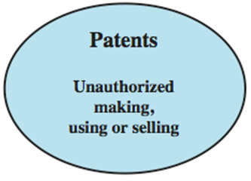
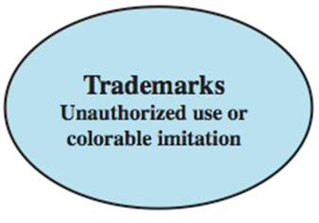
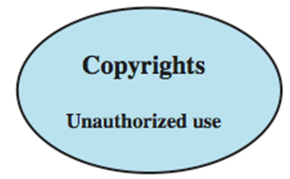
Intellectual Property
Notes:
The U.S. legal system, and legal systems generally, distinguish three primary types of property: real, personal and intellectual. Intellectual property is any intangible asset that consists of human knowledge and ideas. Examples include software, data, novels, sound recordings, the design of a new type of mousetrap, or a cure for a disease. There are three main types of intellectual property for which legal protection is available: copyrights, trademarks, and patents. The legal protection is against infringement, which is the invasion of the rights secured by, copyrights, trademarks, and patents. The right to seek civil recourse against anyone infringing his or her property is granted to the IP owner. Depending upon the type of IP, infringement may vary, as illustrated in Figure 18.2 from the text.

Slide 14

Copyright
protects tangible or fixed expression of an idea but not the idea itself
is automatically assigned when created
may need to be registered in some countries
exists when:
proposed work is original
creator has put original idea in concrete form
e.g. literary works, musical works, dramatic works, pantomimes and choreographic works, pictorial, graphic, and sculptural works, motion pictures and other audiovisual works, sound recordings, architectural works, software-related works.
Notes:
Copyright law protects the tangible or fixed expression of an idea, not the idea itself. Copyright is automatically assigned to newly created works in countries that subscribe to the Berne convention, which encompasses the vast majority of nations. Some countries, such as the United States, provide additional legal protection if the work is registered. Copyright exists if the following conditions are fulfilled:
• the proposed work is original
• the creator has put this original idea into a concrete form, such as hard copy (paper), software, or multimedia form
Examples of items that may be copyrighted include: literary works, musical works, dramatic works, pantomimes and choreographic works, pictorial, graphic, and sculptural works, motion pictures and other audiovisual works, sound recordings, architectural works, software-related works.

Slide 15

Copyright Rights
Copyright owner has these exclusive rights, protected against infringement:
Reproduction right: lets the owner make copies of a work
Modification right: (the derivative-works right), concerns modifying a work to create a new or derivative work
Distribution right: lets the owner publicly sell, rent, lease, or lend copies of the work
Public-performance right: applies mainly to live performances
Public-display right: lets the owner publicly show a copy of the work directly or by means of a film, slide, or television image
Notes:
The copyright owner has the following exclusive rights, protected against infringement:
• Reproduction right: lets the owner make copies of a work.
• Modification right: also known as the derivative-works right, concerns modifying a work to create a new or derivative work.
• Distribution right: lets the owner publicly sell, rent, lease, or lend copies of the work.
• Public-performance right: applies mainly to live performances.
• Public-display right: lets the owner publicly show a copy of the work directly or by means of a film, slide, or television image.

Slide 16
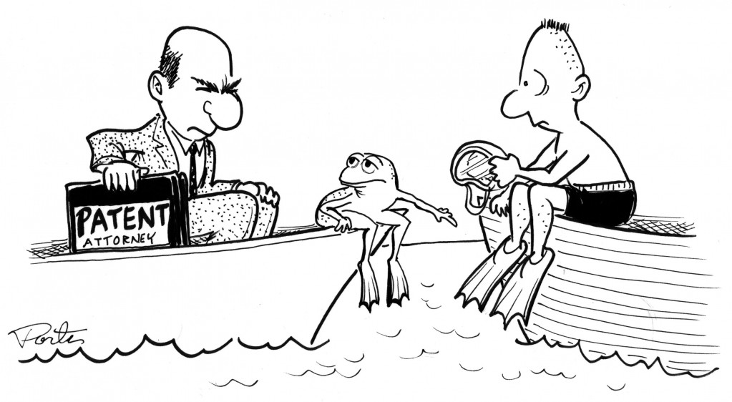
Patents
grant a property right
to the inventor
to exclude others from making, using, offering for sale, or selling the invention
types:
utility - any new and useful process, machine, article of manufacture, or composition of matter
design - new, original, and ornamental design for an article of manufacture
plant - discovers and asexually reproduces any distinct and new variety of plant
Notes:
A patent for an invention is the grant of a property right to the inventor. The right conferred by the patent grant is, in the language of the U.S. statute and of the grant itself, "the right to exclude others from making, using, offering for sale, or selling" the invention in the United States or "importing" the invention into the United States. Similar wording appears in the statutes of other nations.
There are three types of patents:
• Utility patents: may be granted to anyone who invents or discovers any new and useful process, machine, article of manufacture, or composition of matter, or any new and useful improvement thereof;
• Design patents: may be granted to anyone who invents a new, original, and ornamental design for an article of manufacture; and
• Plant patents: may be granted to anyone who invents or discovers and asexually reproduces any distinct and new variety of plant.
An example of a patent from the computer security realm is the RSA public-key cryptosystem. From the time it was granted in 1983 until the patent expired in 2000, the patent holder, RSA Security, was entitled to receive a fee for each implementation of RSA.

Slide 17

Trademarks
a word, name, symbol, or device
used in trade with goods
indicate source of goods
to distinguish them from goods of others
trademark rights may be used to:
prevent others from using a confusingly similar mark
but not to prevent others from making the same goods or from selling the same goods or services under a clearly different mark
Notes:
A trademark is a word, name, symbol, or device that is used in trade with goods to indicate the source of the goods and to distinguish them from the goods of others. A servicemark is the same as a trademark except that it identifies and distinguishes the source of a service rather than a product. The terms trademark and mark are commonly used to refer to both trademarks and servicemarks. Trademark rights may be used to prevent others from using a confusingly similar mark, but not to prevent others from making the same goods or from selling the same goods or services under a clearly different mark.

Slide 18

Intellectual Property Issues
software programs
protect using copyright,
perhaps patent
algorithms
may be able to protect by patenting
databases
protect using copyright
digital content (audio/video/media/web)
protect using copyright
Notes:
Intellectual Property Relevant to Network and Computer Security include:
• Software: This includes programs produced by vendors of commercial software (e.g., operating systems, utility programs, applications) as well as shareware, proprietary software created by an organization for internal use, and software produced by individuals. For all such software, copyright protection is available if desired. In some cases, a patent protection may also be appropriate.
• Databases: A database may consist of data that is collected and organized in such a fashion that it has potential commercial value. An example is an economic forecasting database. Such databases may be protected by copyright.
• Digital content: This category includes audio files, video files, multimedia, courseware, Web site content, and any other original digital work that can be presented in some fashion using computers or other digital devices.
• Algorithms: An example of a patentable algorithm, previously cited, is the RSA public-key cryptosystem.

Slide 19
U.S. Digital Millennium Copyright ACT
DMCA
implements WIPO treaties to strengthen protections of digital copyrighted materials
encourages copyright owners to use technological measures to protect their copyrighted works, including:
measures that prevent access to the work
measures that prevent copying of the work
prohibits attempts to bypass the measures
have both criminal and civil penalties for this
Notes:
The U.S. Digital Millennium Copyright ACT (DMCA) has had a profound effect on the protection of digital content rights in both the U.S. and worldwide. The DMCA, signed into law in 1998, is designed to implement World Intellectual Property Organization (WIPO) treaties, signed in 1996. In essence, DMCA strengthens the protection of copyrighted materials in digital format.
The DMCA encourages copyright owners to use technological measures to protect copyrighted works. These measures fall into two categories: measures that prevent access to the work and measures that prevent copying of the work. Further, the law prohibits attempts to bypass such measures. Specifically, the law states that "No person shall circumvent a technological measure that effectively controls access to a work protected under this title." Among other effects of this clause, it prohibits almost all unauthorized decryption of content. The law further prohibits the manufacture, release, or sale of products, services, and devices that can crack encryption designed to thwart either access to or copying of material unauthorized by the copyright holder. Both criminal and civil penalties apply to attempts to circumvent technological measures and to assist in such circumvention.

Slide 20
DMCA Exemptions
certain actions are exempted from the DMCA provisions:
fair use
reverse engineering
encryption research
security testing
personal privacy
considerable concern exists that DMCA inhibits legitimate security/crypto research
Feel that innovation and academic freedom is stifled and open source software development is threatened
Notes:
Certain actions are exempted from the provisions of the DMCA and other copyright laws, including the following:
• Fair use: This concept is not tightly defined. It is intended to permit others to perform, show, quote, copy, and otherwise distribute portions of the work for certain purposes, including review, comment, and discussion of copyrighted works.
• Reverse engineering: of a software product is allowed if the user has the right to use a copy of the program and if the purpose of the reverse engineering is not to duplicate the functionality of the program but rather to achieve interoperability.
• Encryption research: "Good faith" encryption research is allowed. This exemption allows decryption attempts to advance the development of encryption technology.
• Security testing: is the access of a computer or network for the good faith testing, investigating, or correcting a security flaw or vulnerability, with the authorization of the owner or operator.
• Personal privacy: is generally permitted to bypass technological measures if that is the only reasonable way to prevent the access to result in the revealing or recording of personally identifying information.
Despite the exemptions built into the act, there is considerable concern, especially in the research and academic communities, that the act inhibits legitimate security and encryption research. These parties feel that DMCA stifles innovation and academic freedom and is a threat to open source software development

Slide 21
Digital Rights Management (DRM)
systems and procedures ensuring digital rights holders are clearly identified and receive stipulated payment for their works
may impose further restrictions on their use
no single DRM standard or architecture
objective is to provide mechanisms for the complete content management lifecycle
provide persistent content protection for a variety of digital content types/platforms/media
Notes:
Digital Rights Management (DRM) refers to systems and procedures that ensure that holders of digital rights are clearly identified and receive the stipulated payment for their works. The systems and procedures may also impose further restrictions on the use of digital objects, such as inhibiting printing or prohibiting further distribution.
There is no single DRM standard or architecture. DRM encompasses a variety of approaches to intellectual property management and enforcement by providing secure and trusted automated services to control the distribution and use of content. In general, the objective is to provide mechanisms for the complete content management lifecycle (creation, subsequent contribution by others, access, distribution, use), including the management of rights information associated with the content.
DRM systems should meet the following objectives:
1. Provide persistent content protection against unauthorized access to the digital content, limiting access to only those with the proper authorization.
2. Support a variety of digital content types (e.g., music files, video streams, digital books, images).
3. Support content use on a variety of platforms, (e.g., PCs, PDAs, iPods, mobile phones).
4. Support content distribution on a variety of media, including CD-ROMs, DVDs, and flash memory.

Slide 22
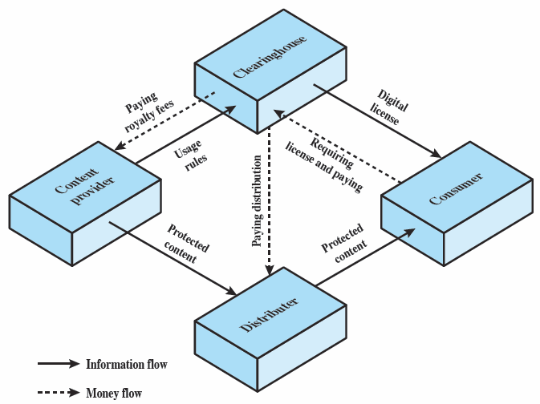
DRM Components
Notes:
Figure 18.3 from the text, illustrates a typical DRM model in terms of the principal users of DRM systems. These are:
• Content provider: Holds the digital rights of the content and wants to protect these rights. Examples are a music record label and a movie studio.
• Distributor: provides distribution channels, such as an online shop or a Web retailer. e.g. an online distributor receives digital content from the content provider and creates a Web catalogue presenting the content and rights metadata for its promotion.
• Consumer: Uses the system to access the digital content by retrieving downloadable or streaming content through the distribution channel and then paying for the digital license. The player/viewer application used by the consumer takes charge of initiating license request to the clearinghouse and enforcing the content usage rights.
• Clearinghouse: Handles the financial transaction for issuing the digital license to the consumer and pays royalty fees to the content provider and distribution fees to the distributor accordingly. The clearinghouse is also responsible for logging license consumptions for every consumer.
In this model, the distributor need not enforce the access rights. Instead, the content provider protects the content in such a way (typically encryption) that the consumer must purchase a digital license and access capability from the clearinghouse. The clearinghouse consults usage rules provided by the content provider to determine what access is permitted and the fee for a particular type of access. Having collected the fee, the clearinghouse credits the content provider and distributor appropriately.

Slide 23
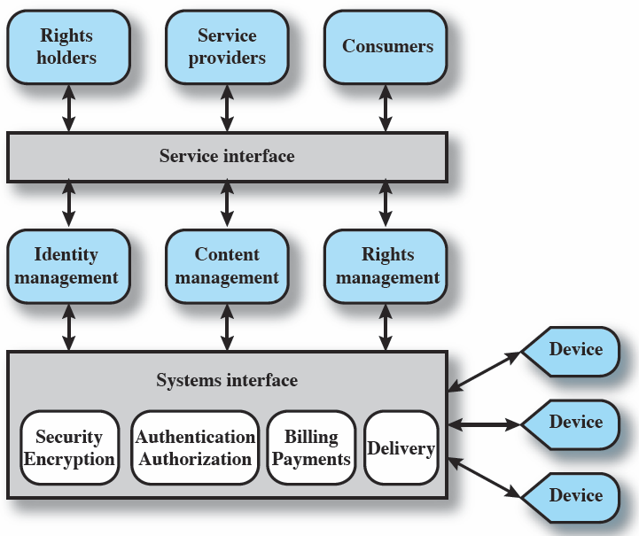
DRM System Architecture
Notes:
Figure 18.4 shows a generic system architecture to support DRM functionality.
The system is access by parties in three roles. Rights holders are the content providers, who either created the content or have acquired rights to the content. Service providers include distributors and clearinghouses. Consumers are those who purchase the right to access to content for specific uses.
There is system interface to the services provided by the DRM system:
• Identity management: mechanisms for unique entities, such as parties and content.
• Content management: processes and functions to manage the content lifecycle.
• Rights management: processes and functions needed to manage rights, rights holders, and associated requirements.
Below these management modules are common functions. The security/encryption module provides functions to encrypt content and to sign license agreements. The identity management service makes use of the authentication and authorization functions to identify all parties in the relationship. Using these functions, the identity management service includes the following: Allocation of unique party identifiers, User profile and preferences, User's device management, Public key management.
Billing/payments functions deal with the collection of usage fees from consumers and the distribution of payments to rights holders and distributors. Delivery functions deal with the delivery of content to consumers.

Slide 24
Privacy
overlaps with computer security
have dramatic increase in scale of info collected and stored
motivated by law enforcement, national security, economic incentives
Individuals have become increasingly aware of
access and use of personal information and private details about their lives
Concerns about extent of privacy compromise have
led to a variety of legal and technical approaches to reinforcing privacy rights
Notes:
An issue with considerable overlap with computer security is that of privacy. On
one hand, the scale and interconnectedness of personal information collected and
stored in information systems has increased dramatically, motivated by law enforcement,
national security, and economic incentives. The last mentioned has been
perhaps the main driving force. In a global information economy, it is likely that the
most economically valuable electronic asset is aggregations of information on individuals
[JUDY14]. On the other hand, individuals have become increasingly aware
of the extent to which government agencies, businesses, and even Internet users have
access to their personal information and private details about their lives and activities.
Concerns about the extent to which personal privacy has been and may be
compromised have led to a variety of legal and technical approaches to reinforcing
privacy rights.

Slide 25
EU Directive on Data Protection
European Union Data Protection Directive was adopted in 1998 to:
ensure member states protect fundamental privacy rights when processing personal info
prevent member states from restricting the free flow of personal info within EU
organized around principles of:
notice, consent, consistency, access, security, onward transfer, enforcement
Notes:
A number of international organizations and national governments have introduced laws and regulations intended to protect individual privacy.
European Union Data Protection Directive was adopted in 1998, to both (1) ensure that member states protected fundamental privacy rights when processing personal information, and (2) prevent member states from restricting the free flow of personal information within the EU. The Directive is organized around the following principles of personal information use:
• Notice: organizations must notify individuals what personal information they are collecting, the uses of that information, and what choices the individual may have.
• Consent: individuals must be able to choose whether and how their personal information is used by, or disclosed to, third parties. They have the right not to have any sensitive information collected or used without express permission, including race, religion, health, union membership, beliefs, and sex life.
• Consistency: organizations may use personal information only in accordance with the terms of the notice given the data subject and the choices the make on its use
• Access: individuals must have the right and ability to access their information and correct, modify, or delete any portion of it.
• Security: organizations must provide adequate security, using technical and other means, to protect the integrity and confidentiality of personal information.
• Onward transfer: third parties receiving personal information must provide the same level of privacy protection as the organization from whom the information is obtained.
• Enforcement: grants a private right of action to data subjects when organizations do not follow the law.

Slide 26
US Privacy Initiatives
have Privacy Act of 1974 which:
Deals with personal information collected and used by federal agencies
Permits individuals to determine records kept
Permits individuals to forbid records being used for other purposes
Permits individuals to obtain access to records and to correct and amend records as appropriate
Ensures agencies properly collect, maintain, and use personal information
Creates a private right of action for individuals
also have a range of other privacy laws
Notes:
The first comprehensive privacy legislation adopted in the United States was the Privacy Act of 1974, which dealt with personal information collected and used by federal agencies. The act is intended to:
1. Permit individuals to determine what records pertaining to them are collected, maintained, used, or disseminated.
2. Permit individuals to forbid records obtained for one purpose to be used for another purpose without consent.
3. Permit individuals to obtain access to records pertaining to them and to correct and amend such records as appropriate.
4. Ensure that agencies collect, maintain, and use personal information in a manner that ensures that the information is current, adequate, relevant, and not excessive for its intended use.
5. Create a private right of action for individuals whose personal information is not used in accordance with the act.
As with all privacy laws and regulations, there are exceptions and conditions attached to this act, such as criminal investigations, national security concerns, and conflicts between competing individual rights of privacy.
While the 1974 Privacy Act covers government records, a number of other U.S. laws have been enacted that cover other areas, including: Banking and financial records, Credit , Medical and health insurance records, Children's privacy, Electronic communications.

Slide 27
ISO 27002 states
“An organizational data protection and privacy policy should be developed and implemented. This policy should be communicated to all persons involved in the processing of personal information. Compliance with this policy and all relevant data protection legislation and regulations requires appropriate management structure and control. Often this is best achieved by the appointment of a person responsible, such as a data protection officer, who should provide guidance to managers, users, and service providers on their individual responsibilities and the specific procedures that should be followed. Responsibility for handling personal information and ensuring awareness of the data protection principles should be dealt with in accordance with relevant legislation and regulations. Appropriate technical and organizational measures to protect personal information should be implemented.”
Notes:
Organizations need to deploy both management controls and technical measures to comply with laws and regulations concerning privacy as well as to implement corporate policies concerning employee privacy. ISO 17799 (Code of Practice for Information Security Management) states the requirement as follows:
ISO 17799: Data protection and privacy of personal information
An organizational data protection and privacy policy should be developed and implemented. This policy should be communicated to all persons involved in the processing of personal information. Compliance with this policy and all relevant data protection legislation and regulations requires appropriate management structure and control. Often this is best achieved by the appointment of a person responsible, such as a data protection officer, who should provide guidance to managers, users, and service providers on their individual responsibilities and the specific procedures that should be followed. Responsibility for handling personal information and ensuring awareness of the data protection principles should be dealt with in accordance with relevant legislation and regulations. Appropriate technical and organizational measures to protect personal information should be implemented.

Slide 28
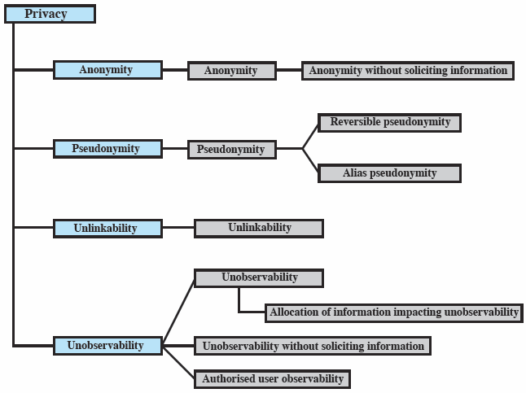
Common Criteria Privacy Class
Notes:
The Common Criteria specification includes a definition of a set of functional requirements in a Privacy Class, which should be implemented in a trusted system. The purpose of the privacy functions is to provide a user protection against discovery and misuse of identity by other users. It is primarily concerned with the privacy of an individual with respect to their use of computer resources, rather than the privacy of their personal information. This specification is a useful guide to how to design privacy support functions as part of a computer system.
Figure 18.5 shows a breakdown of privacy into four major areas:
• Anonymity: Ensures that a user may use a resource or service without disclosing the user’s identity. Specifically, this means that other users or subjects are unable to determine the identity of a user bound to a subject (e.g., process or user group) or operation. It further means that the system will not solicit the real name of a user. Anonymity need not conflict with authorization and access control functions, which are bound to computer-based user IDs, not to personal user information.
• Pseudonymity: ensures that a user may use a resource or service without disclosing its user identity, but can still be accountable for that use. The system shall provide an alias to prevent other users from determining a user's identity but the system shall be able to determine the user's identity from an assigned alias.
• Unlinkability: ensures that a user may make multiple uses of resources or services without others being able to link these uses together.
• Unobservability: ensures that a user may use a resource or service without others, especially third parties, being able to observe that the resource or service is being used.

Slide 29
Privacy and Data Surveillance
Demands of homeland security and counterterrorism have imposed new threats to personal privacy
Law enforcement and intelligence agencies have become increasingly aggressive in using data surveillance techniques to fulfill their mission
Private organizations are exploiting a number of trends to increase their ability to build detailed profiles of individuals
Spread of the Internet
Increase in electronic payment methods
Near-universal use of cellular phone communications
Ubiquitous computation
Sensor webs
Both policy and technical approaches are needed to protect privacy when both government and nongovernment organizations seek to learn as much as possible about individuals
Notes:
The demands of homeland security and counterterrorism have imposed new threats
to personal privacy. Law enforcement and intelligence agencies have become
increasingly aggressive in using data surveillance techniques to fulfill their mission.
In addition, private organizations are exploiting a number of trends to increase their
ability to build detailed profiles of individuals, including the spread of the Internet,
the increase in electronic payment methods, near-universal use of cellular phone
communications, ubiquitous computation, sensor webs, and so on.
Both policy and technical approaches are needed to protect privacy when both
government and nongovernment organizations seek to learn as much as possible
about individuals.

Slide 30
Privacy Protection
In terms of technical approaches the requirements for privacy protection for information systems can be addressed in the context of database security
Tamper-resistant
Cryptographically protected interposed between a database and the access interface
Analogous to a firewall or intrusion prevention device
Verifies user access permissions and credentials
Creates an audit log
The owner of a database installs a privacy appliance tailored to the database content and structure and to its intended use by outside organizations
An independently operated privacy appliance can interact with multiple databases from multiple organizations to collect and interconnect data for their ultimate use by law enforcement, an intelligence user, or other appropriate user
Notes:
In terms of technical approaches, the requirements for privacy
protection for information systems can be addressed in the context of database
security. That is, the approaches that are appropriate for privacy protection involve
technical means that have been developed for database security. These are discussed
in detail in Chapter 5 .
A specific proposal for a database security approach to privacy protection
is outlined in [POPP06]. The privacy appliance is a
tamper-resistant, cryptographically protected device that is interposed between a
database and the access interface, analogous to a firewall or intrusion prevention
device. The device implements privacy protection functions, including verifying the
user’s access permissions and credentials and creating an audit log. Some of the
specific functions of the appliance are as follows:
• Data transformation: This function encodes or encrypts portions of the data
so as to preserver privacy but still allow data analysis functions needed for
effective use. An example of such data analysis functions is the detection of
terrorist activity patterns.
• Anonymization: This function removes specific identifying information from
query results, such as last name and telephone number, but creates some
sort of anonymized unique identifier so that analysts can detect connections
between queries.
• Selective revelation: This is a method for minimizing exposure of individual
information while enabling continuous analysis of potentially interconnected
data. The function initially reveals information to the analyst only in sanitized
form, that is, in terms of statistics and categories that do not reveal (directly or
indirectly) anyone’s private information. If the analyst sees reason for concern,
he or she can follow up by seeking permission to get more precise information.
This permission would be granted if the initial information provides sufficient
cause to allow the revelation of more information, under appropriate legal
and policy guidelines.
• Immutable audit: A tamper-resistant method that identifies where data go
and who has seen the data. The audit function automatically and permanently
records all data accesses, with strong protection against deletion, modification,
and unauthorized use.
• Associative memory: This is a software module that can recognize patterns
and make connections between pieces of data that the human user may have
missed or didn’t know existed. With this method, it can discover relationships
quickly between data points found in massive amounts of data.
The owner of a database installs a privacy appliance
tailored to the database content and structure and to its intended use by outside
organizations. An independently operated privacy appliance can interact with
multiple databases from multiple organizations to collect and interconnect data
for their ultimate use by law enforcement, an intelligence user, or other appropriate
user.

Slide 31
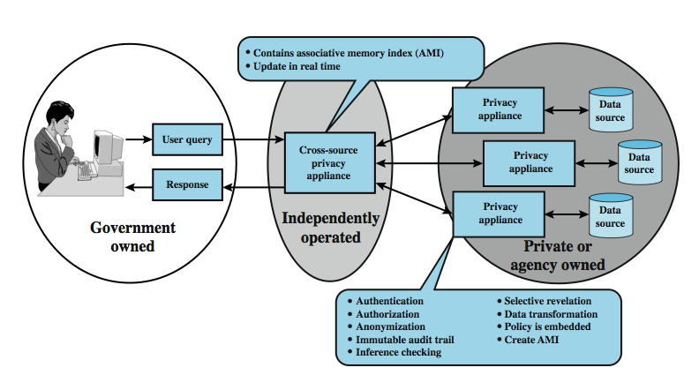
Privacy Protection
Notes:
The demands of homeland security and counterterrorism have imposed new threats to personal privacy. Law enforcement and intelligence agencies have become increasingly aggressive in using data surveillance techniques. Also, private organizations are increasing their ability to build detailed profiles of individuals. Both policy and technical approaches are needed to protect privacy when both government and non-government organizations seek to learn as much as possible about individuals. In terms of technical approaches, the requirements for privacy protection for information systems can be addressed in the context of database security.
Figure 18.6 shows a privacy appliance, which is a tamper-resistant, cryptographically protected device that is interposed between a database and the access interface. It implements privacy protection functions, including verifying the user's access permissions / credentials and creating an audit log. Some of its specific functions are:
• Data transformation: encodes or encrypts portions of the data so as to preserver privacy but still allow data analysis functions needed for effective use.
• Anonymization: removes specific identifying information from query results, replacing themwith an anonymized unique identifier
• Selective revelation: a method for minimizing exposure of individual information while enabling continuous analysis of potentially interconnected data.
• Immutable audit: a method that identifies where data goes and who has seen it.
• Associative memory: a software module that recognizes patterns / connections between pieces of data that the human user may have missed or didn’t know existed.

Slide 32
Ethical Issues
“a system of moral principles relating benefits and harms of particular actions to rightness and wrongness of motives and ends of them”
have many potential misuses / abuses of information and electronic communication that create privacy and security problems
Basic ethical principles developed by civilizations apply
Unique considerations surrounding computers and information systems
Scale of activities not possible before
Creation of new types of entities for which no agreed ethical rules have previously been formed
Notes:
Because of the ubiquity and importance of information systems in organization of
all types, there are many potential misuses and abuses of information and electronic
communication that create privacy and security problems. In addition to questions
of legality, misuse and abuse raise concerns of ethics. Ethics refers to a system of
moral principles that relates to the benefits and harms of particular actions, and to
the rightness and wrongness of motives and ends of those actions. In this section,
we look at ethical issues as they relate to computer and information system security.
To a certain extent, a characterization of what constitutes ethical behavior for
those who work with or have access to information systems is not unique to this
context. The basic ethical principles developed by civilizations apply. However,
there are some unique considerations surrounding computers and information
systems. First, computer technology makes possible a scale of activities not
possible before. This includes a larger scale of recordkeeping, particularly on individuals,
with the ability to develop finer-grained personal information collection
and more precise data mining and data matching. The expanded scale of communications
and the expanded scale of interconnection brought about by the Internet
magnify the power of an individual to do harm. Second, computer technology has
involved the creation of new types of entities for which no agreed ethical rules
have previously been formed, such as databases, Web browsers, chat rooms, cookies,
and so on.

Slide 33
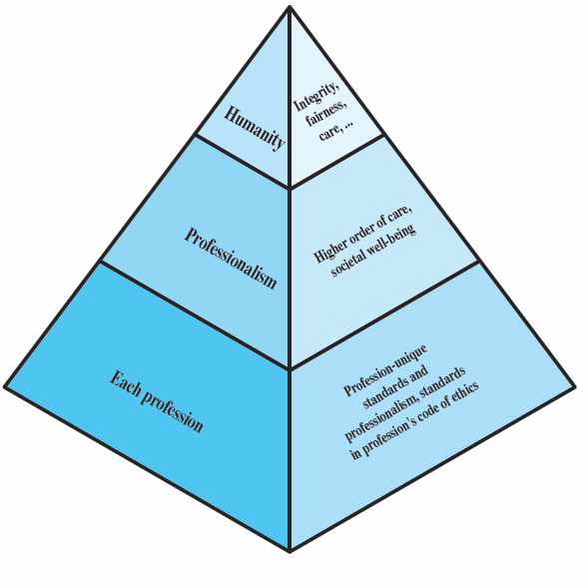
Ethical Hierarchy
Notes:
It has always been the case that those with special knowledge or special skills have additional ethical obligations beyond those common to all humanity. We can illustrate this in terms of an ethical hierarchy , as illustrated in Figure 18.7 from the text. At the top of the hierarchy are the ethical values professionals share with all human beings, such as integrity, fairness, and justice. Being a professional with special training imposes additional ethical obligations with respect to those affected by his or her work. General principles applicable to all professionals arise at this level. Finally, each profession has associated with it specific ethical values and obligations related to the specific knowledge of those in the profession and the powers that they have to affect others. Most professions embody all of these levels in a professional code of conduct, a subject discussed subsequently.

Slide 34
Ethical Issues
some ethical issues from computer use:
repositories and processors of information
producers of new forms and types of assets
instruments of acts
symbols of intimidation and deception
those who understand / exploit technology, and have access permission, have power over these
issue is balancing professional responsibilities with ethical or moral responsibilities
Notes:
Now consider some ethical issues that arise from computer technology. A classic paper on computers and ethics points out that ethical issues arise as the result of the roles of computers, such as:
• Repositories and processors of information: Unauthorized use of otherwise unused computer services or of information stored in computers raises questions of appropriateness or fairness.
• Producers of new forms and types of assets: For example, computer programs are entirely new types of assets, possibly not subject to the same concepts of ownership as other assets.
• Instruments of acts: To what degree must computer services and users of computers, data, and programs be responsible for the integrity and appropriateness of computer output?
• Symbols of intimidation and deception: The images of computers as thinking machines, absolute truth producers, infallible, subject to blame, and as anthropomorphic replacements of humans who err should be carefully considered.
Those who can understand and exploit the technology, plus those who have obtained access permission, have power related to those assets.
Another listing of ethical issues is shown in Table 18.3 in the text.
Both of these lists are concerned with balancing professional responsibilities with ethical or moral responsibilities.

Slide 35

Professional/Ethical Responsibilities
Concern with balancing professional responsibilities with ethical or moral responsibilities
Types of ethical areas a computing/IS professional may face:
Ethical duty as a professional may come into conflict with loyalty to employer
“Blowing the whistle”
Expose a situation that can harm the public or a company’s customers
Potential conflict of interest
Organizations have a duty to provide alternative, less extreme opportunities for the employee
In-house ombudsperson coupled with a commitment not to penalize employees for exposing problems
Professional societies should provide a mechanism whereby society members can get advice on how to proceed
Notes:
We are concerned with balancing professional responsibilities with ethical
or moral responsibilities. We cite two areas here of the types of ethical questions
that face a computing or IS professional. The first is that IS professionals may find
themselves in situations where their ethical duty as professionals comes into conflict
with loyalty to their employer. Such a conflict may give rise for an employee
to consider “blowing the whistle,” or exposing a situation that can harm the public
or a company’s customers. For example, a software developer may know that a
product is scheduled to ship with inadequate testing to meet the employer’s deadlines.
The decision of whether to blow the whistle is one of the most difficult that
an IS professional can face. Organizations have a duty to provide alternative, less
extreme opportunities for the employee, such as an in-house ombudsperson coupled
with a commitment not to penalize employees for exposing problems in-house.
Additionally, professional societies should provide a mechanism whereby society
members can get advice on how to proceed.
Another example of an ethical question concerns a potential conflict of interest.
For example, if a consultant has a financial interest in a certain vendor, this
should be revealed to any client if that vendor’s products or services might be recommended
by the consultant.

Slide 36
Codes of Conduct
ethics not precise laws or sets of facts
many areas may present ethical ambiguity
many professional societies have ethical codes of conduct which can:
be a positive stimulus and instill confidence
be educational
provide a measure of support
be a means of deterrence and discipline
enhance the profession's public image
Notes:
Unlike scientific and engineering fields, ethics cannot be reduced to precise laws or sets of facts. Although an employer or a client of a professional can expect that the professional has an internal moral compass, many areas of conduct may present ethical ambiguities. To provide guidance to professionals and to articulate what employers and customers have a right to expect, a number of professional societies have adopted ethical codes of conduct. A professional code of conduct can:
1. serve as a positive stimulus for ethical conduct on the part of the professional, and to instill confidence in the customer or user of an IS product or service.
2. be educational and inform the professional about what should be their commitment to undertake a certain level of quality of work & their responsibility for the well being of users of their product and the public, to the extent the product may affect non-users. The code also serves to educate managers on their responsibility to encourage and support employee ethical behavior and on their own ethical responsibilities.
3. provide a measure of support for a professional whose decision to act ethically in a situation may create conflict with an employer or customer.
4. be a means of deterrence and discipline. A professional society can use a code as a justification for revoking membership or even a professional license. An employee can use a code as a basis for a disciplinary action.
5. enhance the profession's public image, if it is seen to be widely honored.

Slide 37
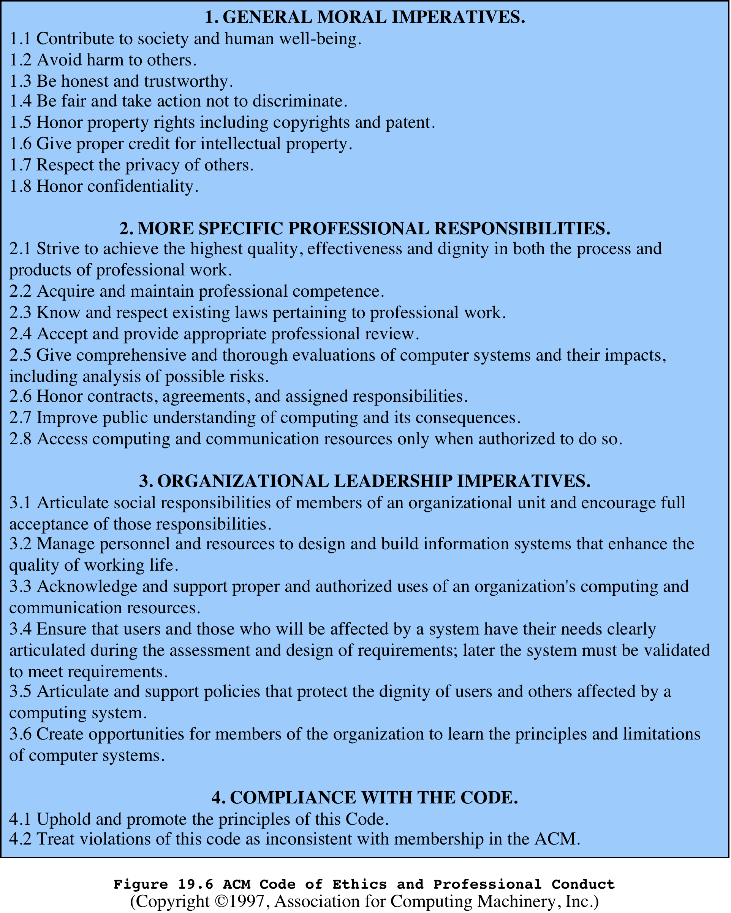
Notes:
We illustrate the concept of a professional code of ethics for computer professionals
with three specific examples. The ACM (Association for Computing
Machinery) Code of Ethics and Professional Conduct ( Figure 19.6 ) applies to
computer scientists

Slide 38
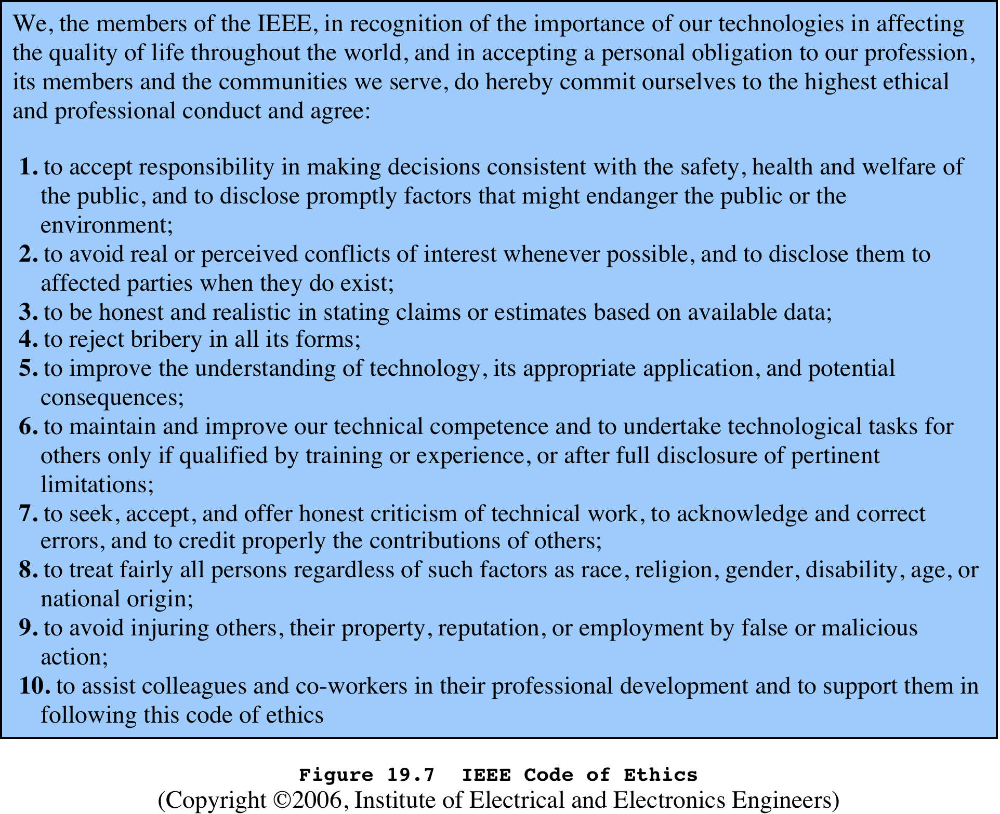
Notes:
The IEEE (Institute of Electrical and Electronic Engineers)
Code of Ethics ( Figure 19.7 ) applies to computer engineers as well as other types
of electrical and electronic engineers.

Slide 39
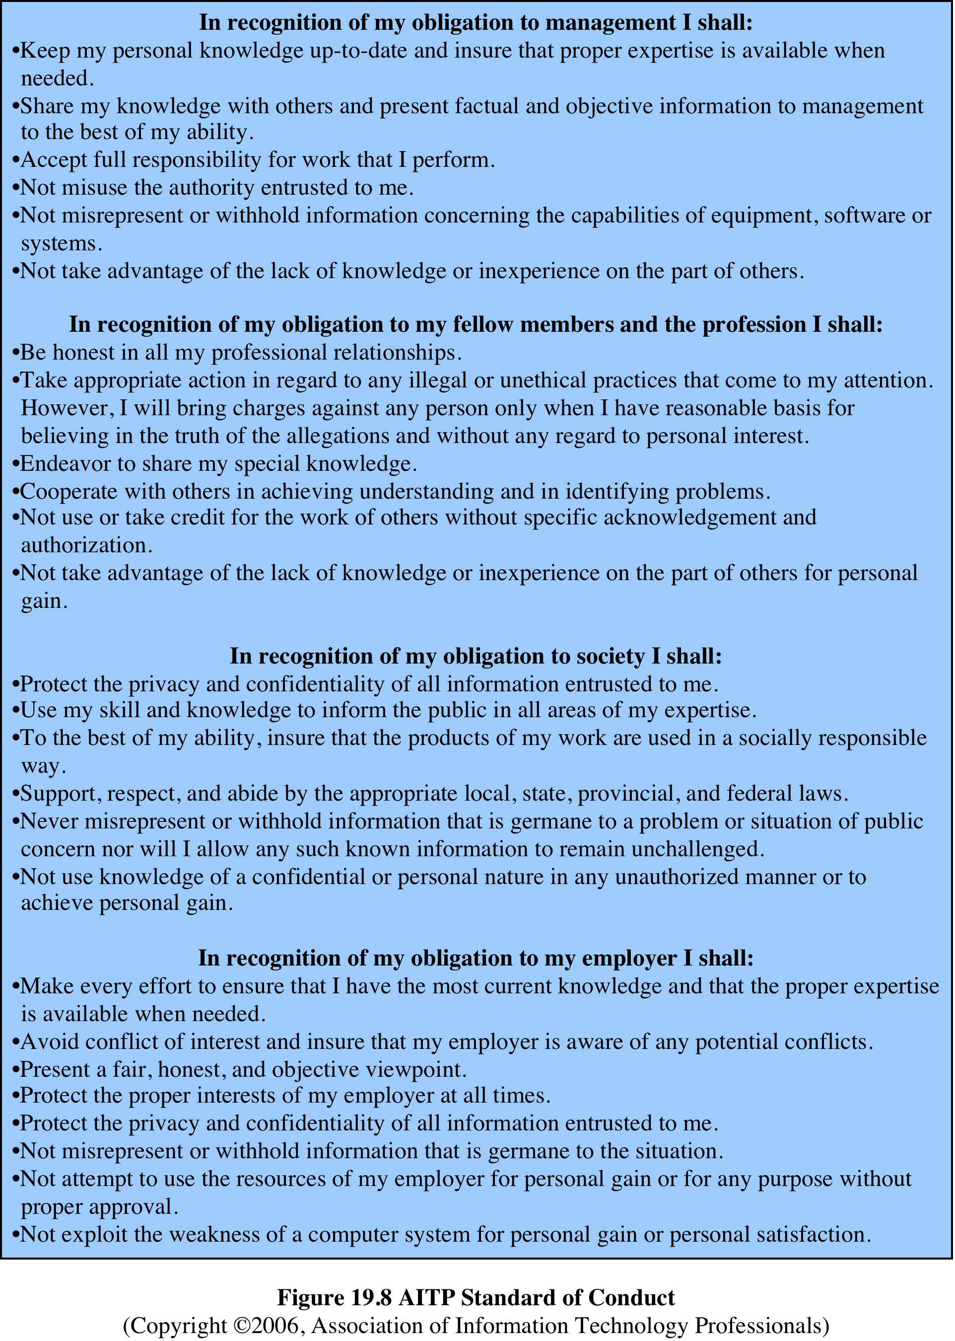
Notes:
The AITP (Association of Information
Technology Professionals, formerly the Data Processing Management
Association) Standard of Conduct ( Figure 19.8) applies to managers of computer
systems and projects.

Slide 40
Comparison of Codes of Conduct
All three codes place their emphasis on the responsibility of professionals to other people
Do not fully reflect the unique ethical problems related to the development and use of computer and IS technology
Common themes:
Dignity and worth of other people
Personal integrity and honesty
Responsibility for work
Confidentiality of information
Public safety, health, and welfare
Participation in professional societies to improve standards of the profession
The notion that public knowledge and access to technology is equivalent to social power
Notes:
A number of common themes emerge from these codes, including (1) dignity
and worth of other people; (2) personal integrity and honesty; (3) responsibility
for work; (4) confidentiality of information; (5) public safety, health, and welfare;
(6) participation in professional societies to improve standards of the profession;
and (7) the notion that public knowledge and access to technology is equivalent to
social power.
All three codes place their emphasis on the responsibility of professionals to
other people, which, after all, is the central meaning of ethics. This emphasis on
people rather than machines or software is to the good. However, the codes make
little specific mention of the subject technology, namely computers and information
systems. That is, the approach is quite generic and could apply to most professions
and does not fully reflect the unique ethical problems related to the development
and use of computer and IS technology. For example, these codes do not specifically
deal with the issues raised by [PARK88] listed in the preceding subsection.

Slide 41

The Rules
Collaborative effort to develop a short list of guidelines on the ethics of computer systems
Ad Hoc Committee on Responsible Computing
Anyone can join this committee and suggest changes to the guidelines
Moral Responsibility for Computing Artifacts
Generally referred to as The Rules
The Rules apply to software that is commercial, free, open source, recreational, an academic exercise or a research tool
Computing artifact
Any artifact that includes an executing computer program
Notes:
A different approach from the ones so far discussed is a collaborative effort to
develop a short list of guidelines on the ethics of developing computer systems. The
guidelines, which continue to evolve, are the product of the Ad Hoc Committee on
Responsible Computing. Anyone can join this committee and suggest changes to
the guidelines. The committee has publish a document, regularly updated, entitled
Moral Responsibility for Computing Artifacts , and is generally referred to as The
Rules . The current version of The Rules is version 27, reflecting the thought and
effort that has gone into this project.
The term computing artifact refers to any artifact that includes an executing
computer program. This includes software applications running on a general
purpose computer, programs burned into hardware and embedded in mechanical
devices, robots, phones, web bots, toys, programs distributed across more than one
machine, and many other configurations. The Rules apply to, among other types:
software that is commercial, free, open source, recreational, an academic exercise or
a research tool.

Slide 42
As of this writing, the rules are as follows:
The people who design, develop, or deploy a computing artifact are morally responsible for that artifact, and for the foreseeable effects of that artifact. This responsibility is shared with other people who design, develop, deploy or knowingly use the artifact as part of a sociotechnical system.
The shared responsibility of computing artifacts is not a zero-sum game. The responsibility of an individual is not reduced simply because more people become involved in designing, developing, deploying, or using the artifact. Instead, a person’s responsibility includes being answerable for the behaviors of the artifact and for the artifact’s effects after deployment, to the degree to which these effects are reasonably foreseeable by that person.
People who knowingly use a particular computing artifact are morally responsible for that use.
People who knowingly design, develop, deploy, or use a computing artifact can do so responsibly only when they make a reasonable effort to take into account the sociotechnical systems in which the artifact is embedded.
People who design, develop, deploy, promote, or evaluate a computing artifact should not explicitly or implicitly deceive users about the artifact or its foreseeable effects, or about the sociotechnical systems in which the artifact is embedded.
Notes:
As of this writing, the rules are as follows:
1. The people who design, develop, or deploy a computing artifact are morally
responsible for that artifact, and for the foreseeable effects of that artifact.
This responsibility is shared with other people who design, develop, deploy or
knowingly use the artifact as part of a sociotechnical system.
2. The shared responsibility of computing artifacts is not a zero-sum game. The
responsibility of an individual is not reduced simply because more people
become involved in designing, developing, deploying, or using the artifact.
Instead, a person’s responsibility includes being answerable for the behaviors
of the artifact and for the artifact’s effects after deployment, to the degree to
which these effects are reasonably foreseeable by that person.
3. People who knowingly use a particular computing artifact are morally responsible
for that use.
4. People who knowingly design, develop, deploy, or use a computing artifact
can do so responsibly only when they make a reasonable effort to take into
account the sociotechnical systems in which the artifact is embedded.
5. People who design, develop, deploy, promote, or evaluate a computing artifact
should not explicitly or implicitly deceive users about the artifact or its foreseeable
effects, or about the sociotechnical systems in which the artifact is embedded.
Compared to the codes of ethics discussed earlier, The Rules are few in
number and quite general in nature. They are intended to apply to a broad spectrum
of people involved in computer system design and development. The Rules have
gathered broad support as useful guidelines by academics, practitioners, computer
scientists, and philosophers from a number of countries [MILL11]. It seems likely
that The Rules will influence future versions of codes of ethics by computer-related
professional organizations.

Slide 43

Summary
Cybercrime and computer crime
Types of computer crime
Law enforcement challenges
Working with law enforcement
Intellectual property
Types of intellectual property
Intellectual property relevant to network and computer security
Digital millennium copyright act
Digital rights management
Privacy
Privacy law and regulation
Organizational response
Computer usage privacy
Privacy and data surveillance
Ethical issues
Ethics and the IS professions
Ethical issues related to computers and information systems
Codes of conduct
The rules
Notes:
Chapter 19 summary.

